Slide 1
Quickgarde: A Plug-in for Detecting Cyberbullying Occurrences in Filipino Social Media Posts
A research project presented to you by:
F. Ballesteros | P.M. Capuz | S. Mallari | E. Samillano

Slide 2
Cyberbullying in the Philippines
a form of harassment that occurs via the Internet which includes vicious forum posts, name calling in chat rooms, creating fake profiles on social networking sites, and sending cruel messages
Notes:
- Place definitions of cyberbullying from different people (experts) and add the team’s own definition of it based from the gathered resources

Slide 3
Cyberbullying Laws in the Philippines
R.A. 10627 - Anti Bullying Act of 2013
House Bill 5718
Notes:
- Place definitions of cyberbullying from different people (experts) and add the team’s own definition of it based from the gathered resources

Slide 4
How do social media platforms deal with cyberbullying?
Privacy Settings
Reporting Tools
YouTube’s Safety Mode
Twitter’s Mute Feature
Notes:
- Place definitions of cyberbullying from different people (experts) and add the team’s own definition of it based from the gathered resources

Slide 5
STATEMENT OF THE PROBLEM
How can cyberbullying statements in Filipino be detected in social media sites?

Slide 6
OBJECTIVES
Main Objective
To create an application that can detect cyberbullying statements in Filipino in social media sites.

Slide 7
OBJECTIVES
Specific Objectives
To gather textual data for the corpus
To perform text preprocessing
To perform text annotation on the dataset
To implement machine learning algorithm using WEKA
To generate a cyberbullying detection model
To develop a cyberbullying detection system
To test system performance

Slide 8
SCOPE AND LIMITATIONS
Corpus: All 2000 statements were extracted from public, controversial posts in Twitter, Facebook, and YouTube
Text preprocessing methods: cleaning of the dataset, tokenization, and conversion of the data to Bag-of-words
Cleaning of the dataset: removing special characters, non-readable text, emoticons, links, and foreign language characters. Basic Jejemon slang was retained in the dataset.
The annotation schemes used are the following: cyberbullying, not cyberbullying, and ambiguous cyberbullying

Slide 9
SCOPE AND LIMITATIONS
The machine learning algorithm that was implemented is the Support Vector Machine (SVM) algorithm
10-fold Cross Validation was used for determining the accuracy and Kappa statistic (metrics) of the model. It yielded an accuracy rate of 57.95% and a Kappa Statistic of 20.94%
The cyberbullying detection model was designed to analyze and classify public posts that were written in Filipino

Slide 10
SCOPE AND LIMITATIONS
The application was programmed using Java
It will come in the form of a website extension or plug-in
Twitter was selected as the application’s testing ground
Twitter4J was the tool used to interact with Twitter API

Slide 11
SCOPE AND LIMITATIONS
Only flagged cyberbullying statements will be reported
Access to the application is limited to social media administrators only
Reports will be arranged in tabular format
Procedures to be implemented by the authorities to resolve the issue is no longer covered in the project

Slide 12
SCOPE AND LIMITATIONS
Detection will be done word per word
The report will contain the post, its annotation, the user who posted it, and the time and date it was posted

Slide 13
SIGNIFICANCE
To social media moderators
To Filipino social media users
To the researchers
To anti-cyberbullying advocates

Slide 14
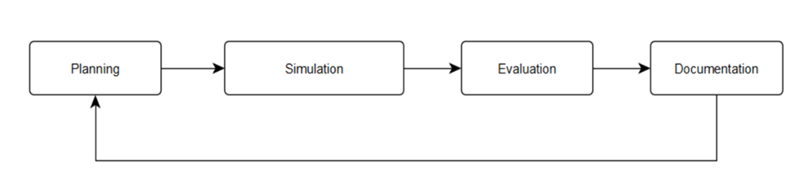
SOFTWARE DEVELOPMENT LIFE CYCLE
Notes:
- Place definitions of cyberbullying from different people (experts) and add the team’s own definition of it based from the gathered resources

Slide 15
Cyberbullying Detection Related Literatures
VS Quickgarde
Related Literatures | Quickgarde
Used popular algorithms for comparison Aimed towards the automation of cyberbullying detection Used the common performance measure metrics: Precision, Recall, F-measure, and Accuracy Different languages for detection | Has a different classification scheme Used all algorithms Aimed towards the detection of cyberbullying detection and generation of reports Used the common performance measure metrics but highlights Matthews Correlations Coefficients score Focused its detection on Filipino Language

Slide 16
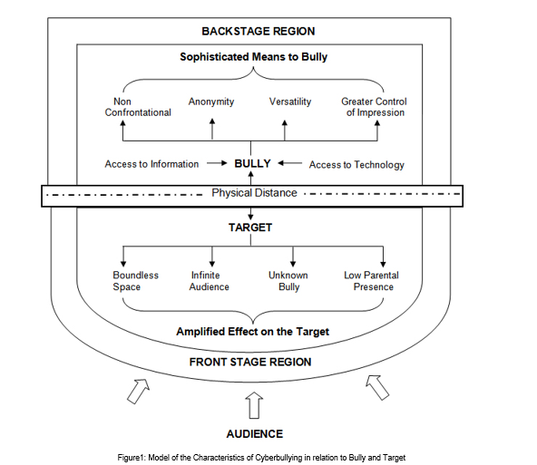
Audience Segregation by Ervin Goffman

Slide 17
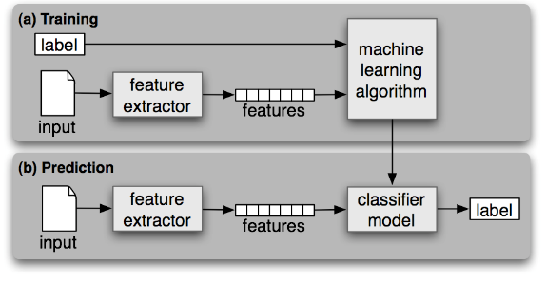
Theoretical Background
Text
Classification

Slide 18
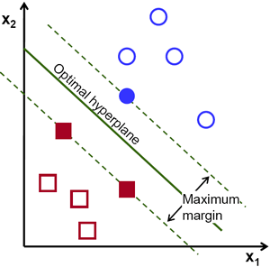
Support Vector
Machine (SVM)

Slide 19
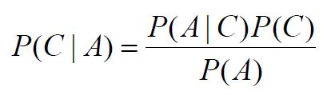

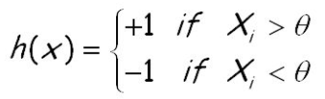
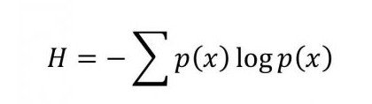

Other Machine Learning Algorithms
Machine Learning Algorithm | Formula
Naïve Bayes
J48
Decision Stump
Random Forest
RepTREE

Slide 20
THEORETICAL BACKGROUND
Other Machine Learning Algorithms
JRip (RIPPER)
Decision Table
OneR
ZeroR

Slide 21
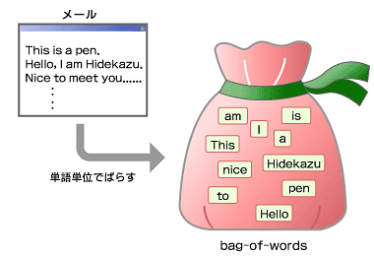
THEORETICAL BACKGROUND
Bag of Words
(BoW)

Slide 22
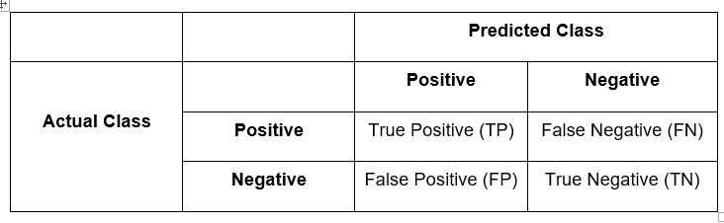
Performance Measure: Confusion Matrix

Slide 23






THEORETICAL BACKGROUND
Performance Measure | Formula
Accuracy
Kappa Statistics
Precision
Recall
F-Measure
Matthew Correlations Coefficient

Slide 24

SYSTEM APPLICATION

Slide 25
OBJECTIVES
Automatically detect cyberbullying statements in the site
Flag detected cyberbullying occurrences
Produce timely and organized reports that can only be accessed by authorized personnel

Slide 26



DESIGN AND METHODOLOGY
Software Applications Used

Slide 27
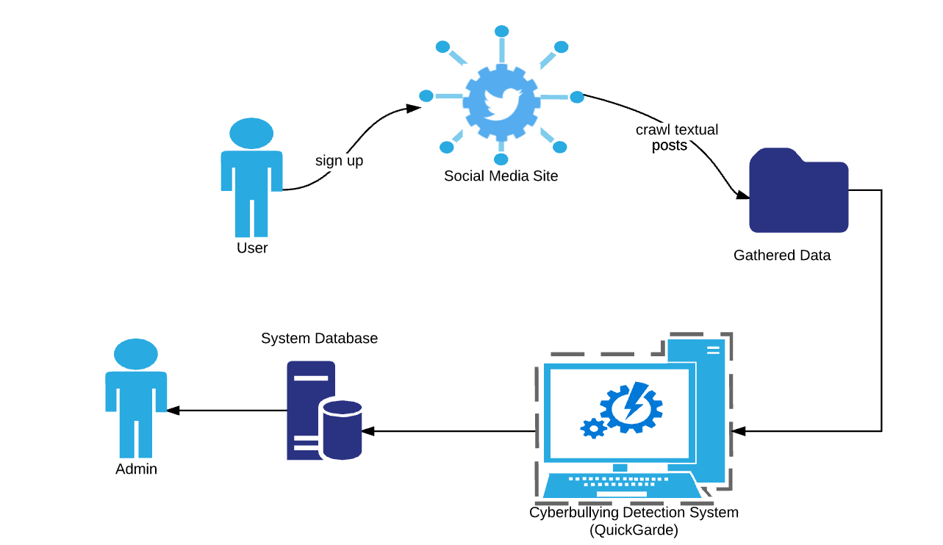
SYSTEM ARCHITECTURE

Slide 28
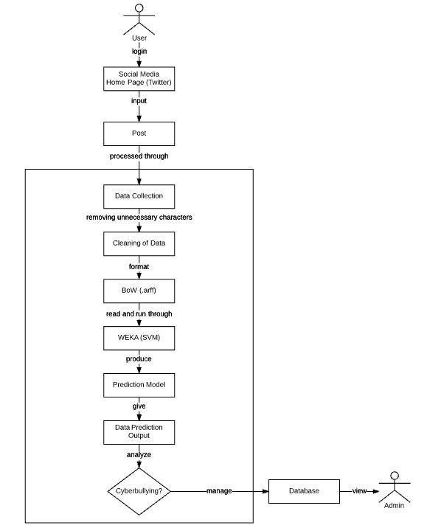

Slide 29
SYSTEM ARCHITECTURE PHASES
Data Collection
Cleaning of the dataset
Data Annotation
Tokenization
Bag of Words
Support Vector Machine
Cyberbullying Detection Model

Slide 30
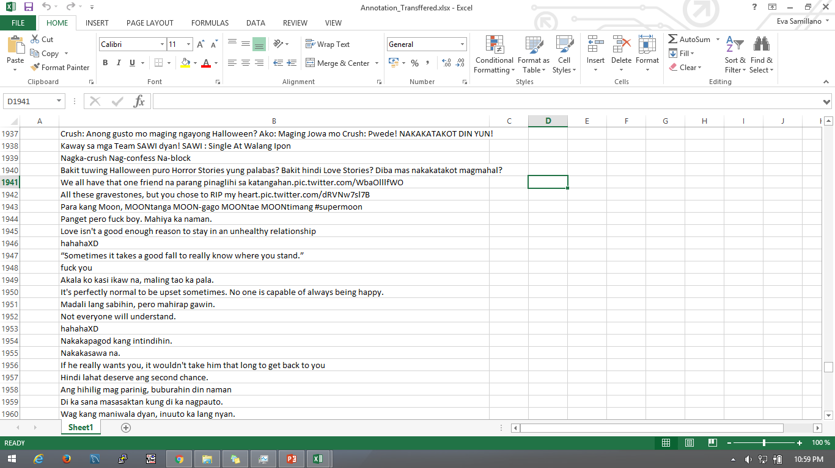
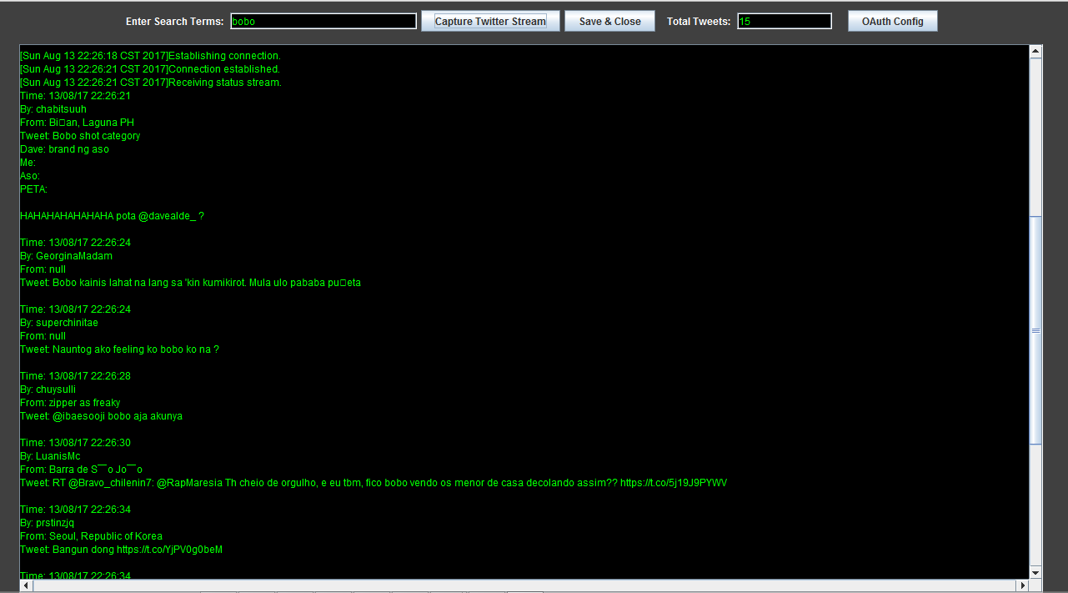
Data Collection
2000 Data | Import.io | Controversial Issue

Slide 31
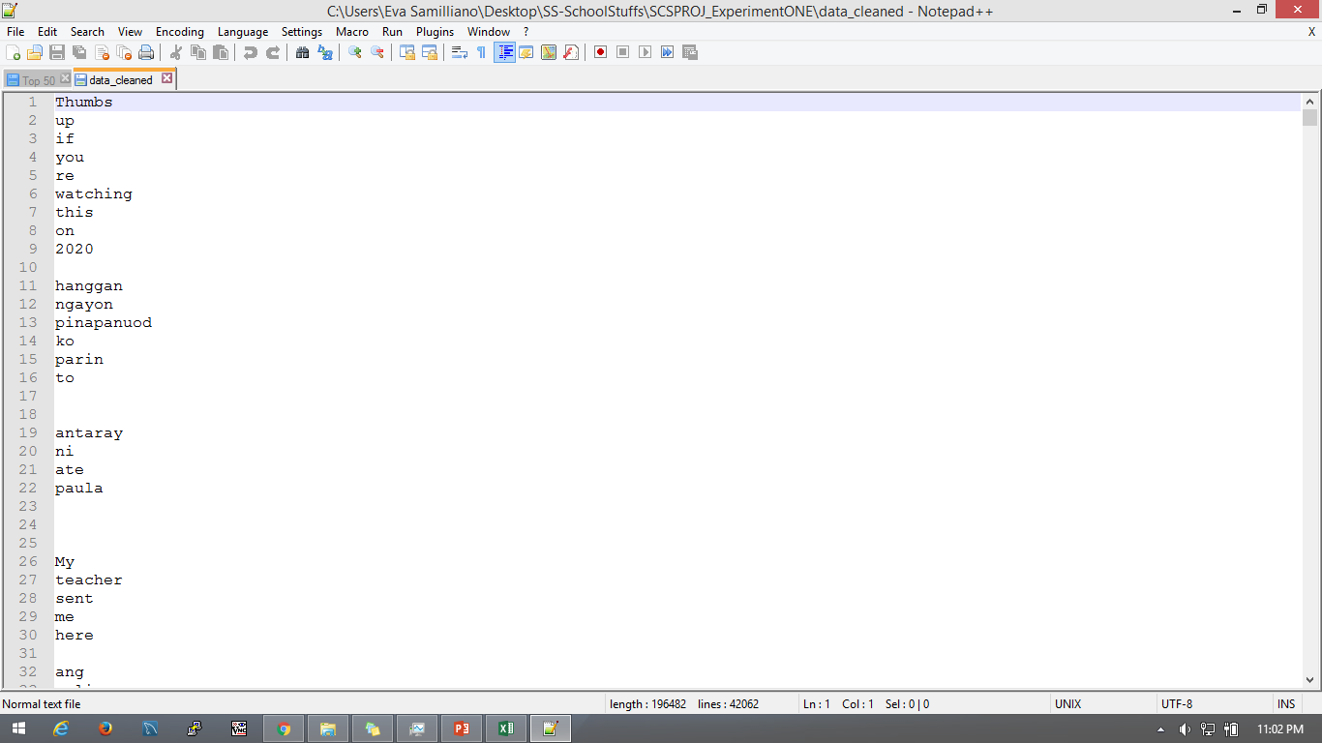
Cleaning of Dataset
!@#$%^&*()-_=+:”;’{}|[]\<>?,./| and not Filipino Language and Links

Slide 32
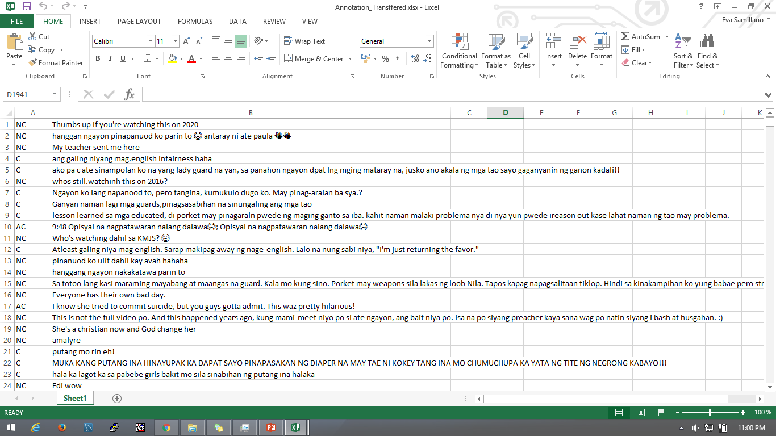
Data Annotation
1=10 Statement/1000 Data | 1000 Data - Researchers

Slide 33
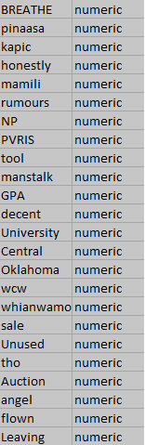
Tokenization
Total of 7062 out of 2000Data

Slide 34
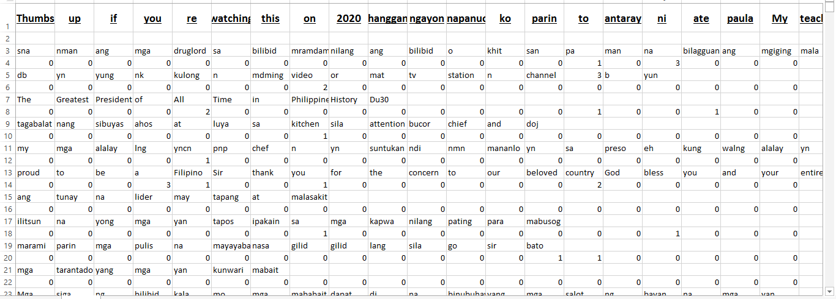
Bag of Words

Slide 35
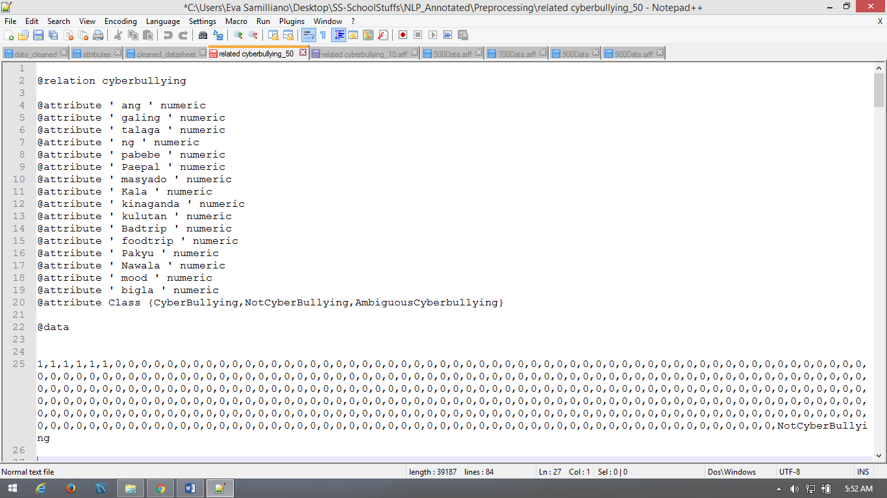
Support Vector Machine

Slide 36
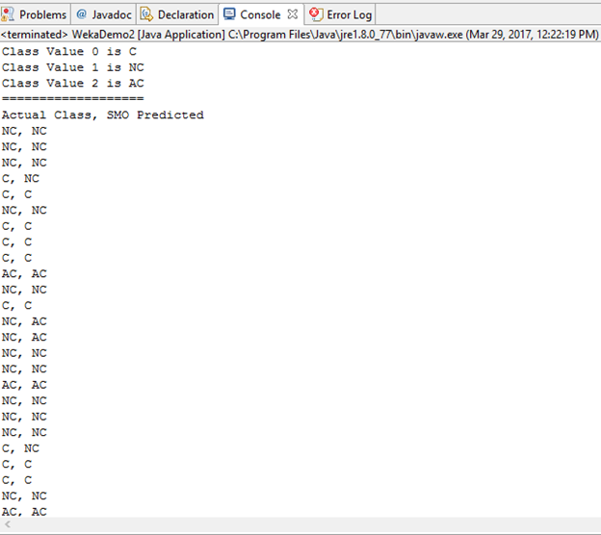
Cyberbullying Detection Output

Slide 37
RESULTS AND DISCUSSION
DATA ANALYSIS

Slide 38
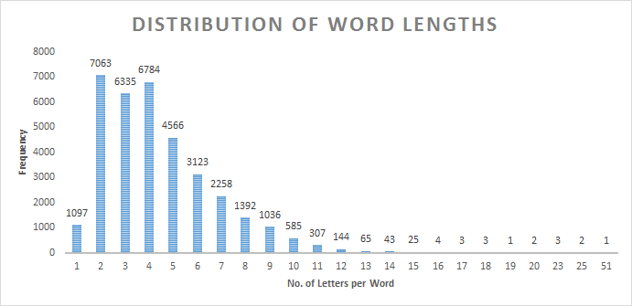
Data Analysis – Length of words per statement

Slide 39
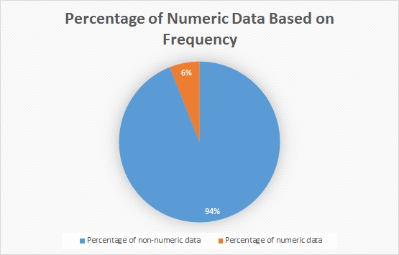
Data Analysis – Presence of numeric Data

Slide 40
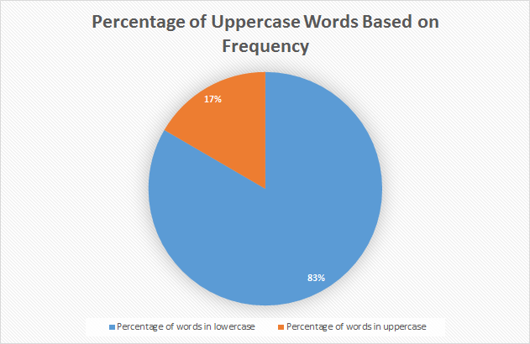
Data Analysis – Presence of words in UpperCase

Slide 41
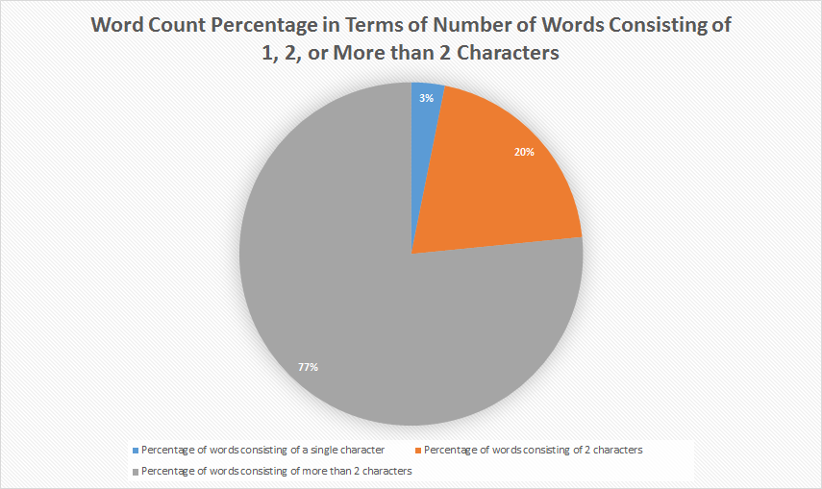
Data Analysis – Presence of words consisting of single or double characters

Slide 42
Data Analysis – Top 50 Cyberbullying Keywords
Rank | Word(s) | No. of occurrences
1 | INA/unu | 566
2 | TANG/tung | 210
3 | puta/putang/pota/PUTANGINA/pokeng | 155
4 | Hahahaha/Hihi/Hehehe | 153
5 | baba | 137
6 | gay | 122
7 | fuck/fucking/FUCKIN/pakyu | 97
8 | HAYOP/KABAYO/ANIMAL/daga/pet/baboy | 95
9 | mamatay/hell/Kill/patay/bitayin | 93
10 | LANDI/itch | 88
11 | gang | 70
12 | pusher/druglord/lord/drug | 70
13 | tawa/Kakatawa | 69
14 | BIG | 64
15 | gago/tado | 62
16 | King | 61
17 | tanga/ulol/ulul | 52

Slide 43
Data Analysis – Top 50 Cyberbullying Keywords
18 | gaga | 47
19 | malandi/Kalandi/baliw/abnoy | 45
20 | loko | 42
21 | bakla/Kadiri | 41
22 | ass/Butt | 39
23 | che | 37
24 | mahina/matanda/slow | 37
25 | hiya | 35
26 | bitch/tarantado | 35
27 | bobo/stupid/kupal | 33
28 | bad | 30
29 | paa/TAE | 29
30 | panga | 26
31 | wawa/Kaawa | 26
32 | baho/kati | 25
33 | punyeta/shit/bwiset/Bullshit | 24
34 | tangina | 23
35 | yaya | 23

Slide 44
Data Analysis – Top 50 Cyberbullying Keywords
36 | adik/salot | 22
37 | mahirap | 21
38 | pabebe/epal | 21
39 | malaki | 17
40 | pangit | 17
41 | BLACK/FAT/Blind/sunog | 17
42 | Bayag/pepe/etits/tuwad/pakantot /boobs/penis | 17
43 | Kapal | 15
44 | Yuck/Ewww | 8
45 | HYPOCRITE/pathetic | 6
46 | bruha/halimaw | 6
47 | demonyo | 4
48 | yawa | 4
49 | engot | 3
50 | inarte | 1

Slide 45
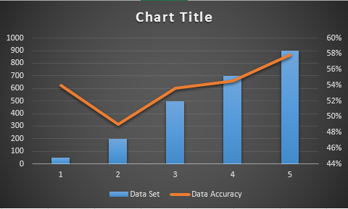
Data Analysis – Adding more data in the dataset

Slide 46
Data Analysis – Percentage Split
Training Data (%) | Testing Data (%) | Accuracy | Kappa Statistics
60 | 40 | 45.8824 | 0.0911
70 | 30 | 47.3333 | 0.114
80 | 20 | 55 | 0.2177
90 | 10 | 50 | 0.1325

Slide 47
Data Analysis – K-Fold Cross Validation
K-Fold | Accuracy | Kappa Statistics
2 | 57.65 | 0.1933
3 | 57.65 | 0.2007
4 | 58.2 | 0.2082
6 | 58.05 | 0.2096
7 | 58.15 | 0.2081
8 | 58.85 | 0.2288
9 | 56.95 | 0.2084
10 | 57.95 | 0.2094

Slide 48
Data Analysis – Using Different Algorithms
Algorithm | Accuracy | Kappa Statistics | Time (seconds)
SVM | 57 | 0.2094 | 47.56
Naïve Bayes | 45.8 | 0.1272 | 4.98
J48 | 53.7 | 0.1619 | 61.84
ZeroR | 56.9 | 0 | 0.02
Decision Stump | 56.9 | 0 | 2.78
RandomTree | 48.55 | 0.1008 | 2.97
RandomForest | 61 | 0.1712 | 40.25
RepTREE | 56.9 | 0.1026 | 14.04
HoeffdingTree | 56.9 | 0 | 17.19
DesicionTable | 58.8 | 0.1173 | 628.02
JRip | 57.9 | 0.0594 | 48.21
OneR | 55 | 0.0431 | 1.45

Slide 49
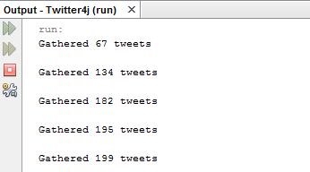
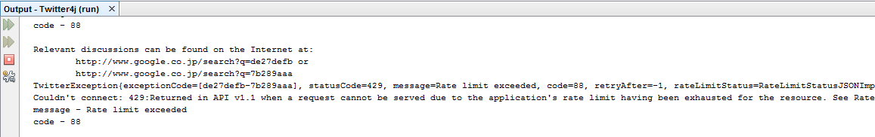
OUTPUTS

Slide 50
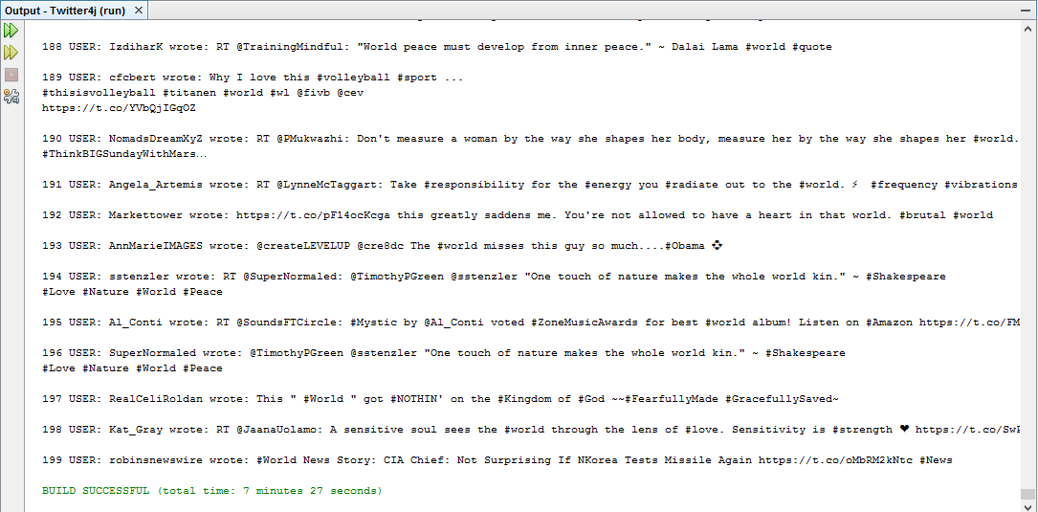
OUTPUTS

Slide 51
OUTPUTS

